Slide 1


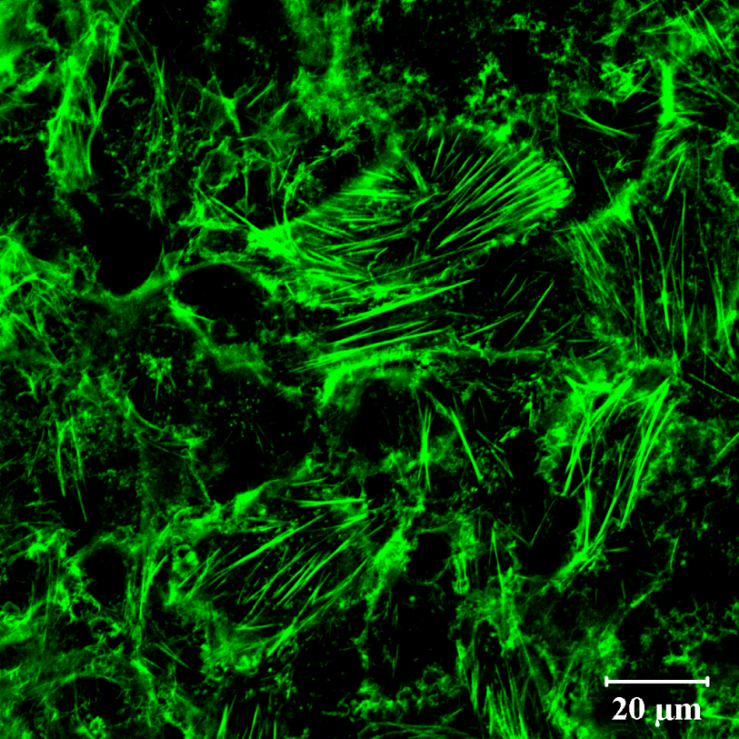
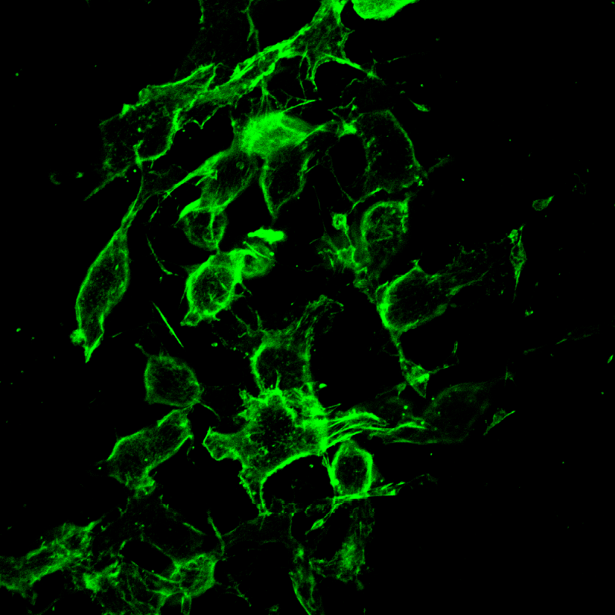
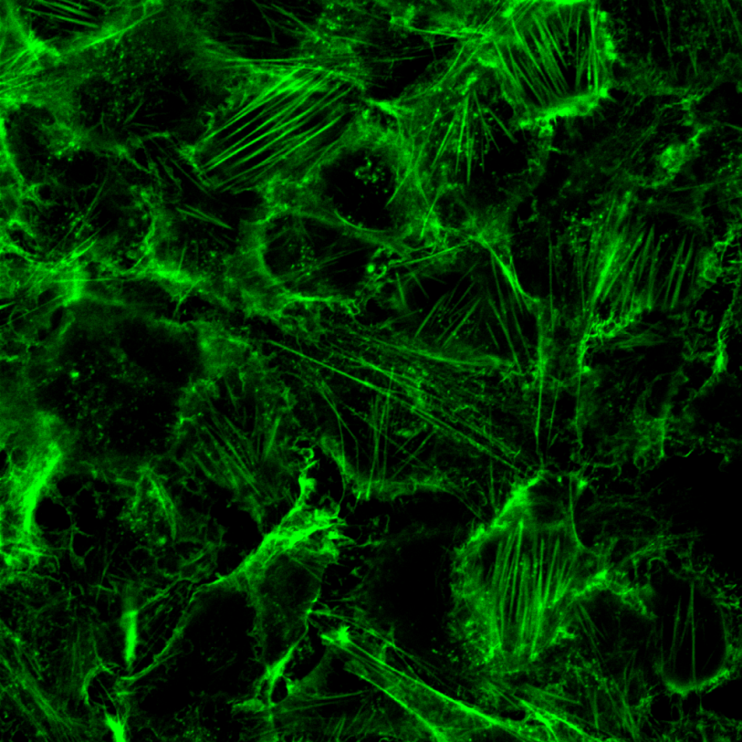
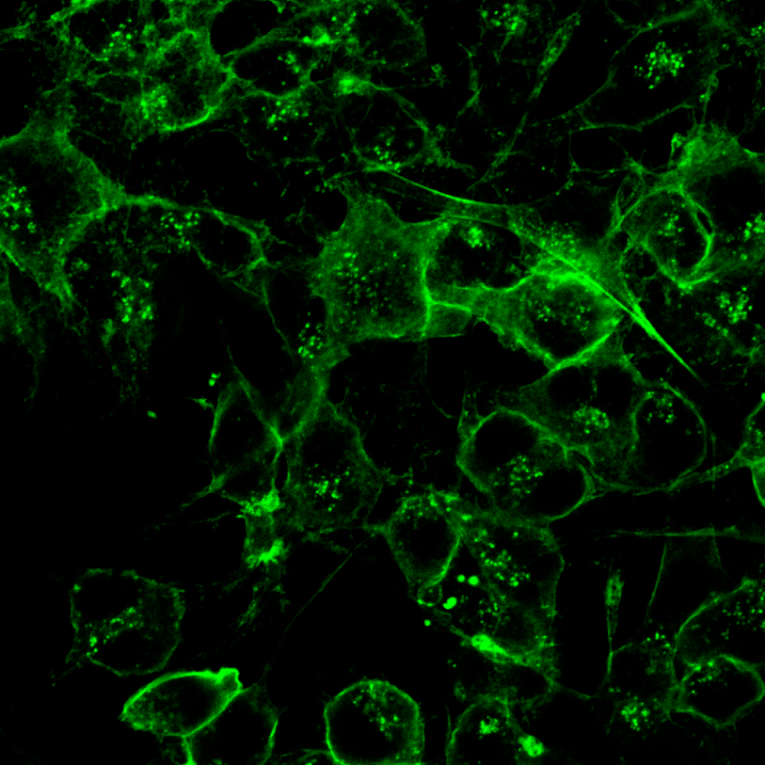
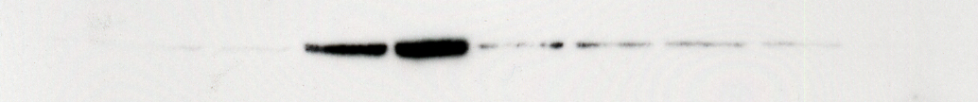

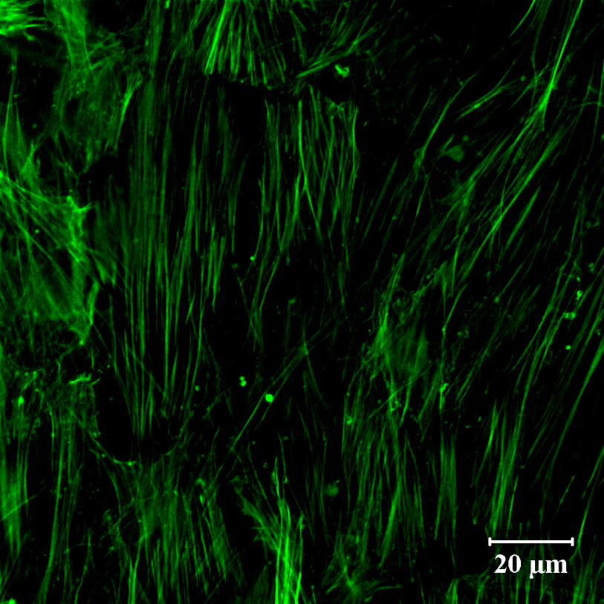
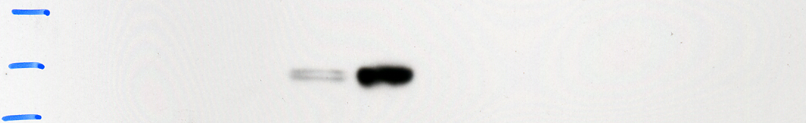
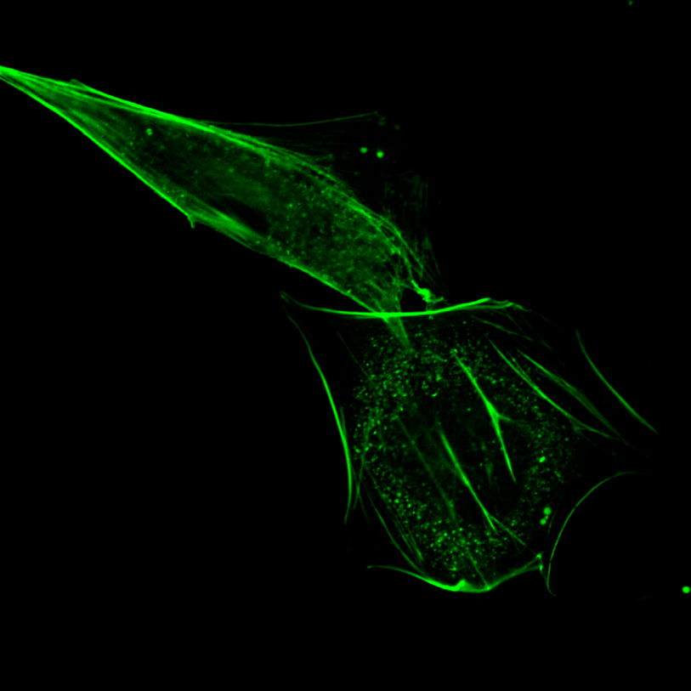
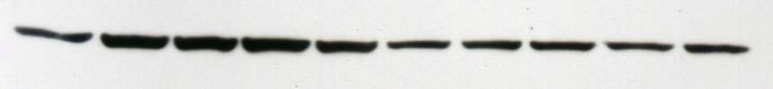
Mechanisms Governing Constitutive TGF-β2 Expression and
Release in Human Trabecular Meshwork Cells
Andrea L. Blitzer¹, Cynthia L. Pervan-Von Zee², Jonathan D. Lautz³,
Kelly A. Langert², and Evan B. Stubbs, Jr.²
¹Stritch School of Medicine, ²Ophthalmology, ³Program of Neuroscience, Loyola University Chicago, Maywood, IL
Research Service (151), Edward Hines, Jr. VA Hospital, Hines, IL
INTRODUCTION
RESULTS
PUTATIVE MECHANISM
Primary open angle glaucoma (POAG) is a leading cause of blindness worldwide, affecting over 2 million individuals aged 45 and over within the US. Clinically, elevated intraocular pressure (IOP) is a key risk factor for the development and progression of POAG.
Harmful elevation of IOP in patients with POAG results from an increase in aqueous humor (AH) outflow resistance, largely localized to the trabecular meshwork (TM). Whereas the pathogenic mechanisms underlying elevated IOP remain poorly understood, endogenous levels of active transforming growth factor (TGF)-β2 are elevated by 60-70% in the AH of POAG patients.¹⁻³ Experimentally, ex vivo perfusion of TGF-β2 significantly enhances outflow resistance through cultured human anterior segments.⁴ TGF-β2 may increase AH outflow resistance through enhanced synthesis and secretion of extracellular matrix (ECM) proteins, as well as ECM-modulating enzymes.^{4,5} Alternatively, we have recently shown that TGF-β2 mediated increases in AH outflow resistance may involve Rho-dependent re-organization of the actin cytoskeleton within human trabecular meshwork cells.⁶
The mechanisms governing TGF-β2 expression within the anterior segment of the eye remains unclear. In the healthy anterior chamber, TGF-β2 is expressed in limbal epithelial cells, the ciliary body, and the conjunctival stroma.⁷ In this study, we examined the mechanisms underlying endogenous synthesis and secretion of TGF-β2 by human TM cells.
Figure 1. Inhibition of geranylgeranylation attenuates endogenous TGF-β2 mRNA expression in human TM cells
Figure 4. Lovastatin attenuates RhoA activation
in human TM cells
Active
TGF-β2
Anterior chamber
Transformed
Primary
HMG-CoA
Rho
GTP
hTM cell
HMG-CoA reductase
Lovastatin
Rho kinase
LIM kinase
Mevalonate
GGTI-298
Mevalonate-5-P
Geranylgeranyl transferase-I
Human TM cells were incubated for 24h in the absence (0.1% ethanol or 0.1 % DMSO) or presence of lovastatin (10 µM) or GGTI-298 (20 µM) as indicated. Relative content of TGF-β2 mRNA was quantified by qRT-PCR. Data shown are the pooled GAPDH-normalized fold changes from three separate experiments (left panel) or a single experiment (right panel) performed in triplicate and expressed as mean ± SD. *p < 0.05 (unpaired Student’s t-test).
Confluent GTM3 cells were incubated in the absence (0.01% ethanol) or presence of lovastatin (10 µM), as indicated. The content of GTP-bound RhoA in cell lysates was quantified by G-LISA. Data shown are pooled from two separate experiments performed in triplicate and expressed as the mean ± SD. *p < 0.001 (unpaired Student’s t-test).¹⁰
Mevalonate-5-PP
Cytoskeletal reorganization
Isopentenyl-PP
Geranyl-PP
+ IPP
Geranylgeranyl-PP (GGPP)
Latent
TGF-β2
Farnesyl-PP (FPP)
GGPP synthetase
METHODS
Figure 2. Inhibition of geranylgeranylation attenuates
constitutive TGF-β2 secretion in human TM cells
Figure 5. Inhibition of geranylgeranylation disrupts endogenous filamentous actin organization in
transformed human TM cells
Squalene
Latency Associated Peptide
Cell Culture: An SV40-transformed human TM cell line was cultured as previously described.⁸ Primary human TM cells were harvested and purified from discarded human corneoscleral rims as we have previously described.⁶ Human TM cell cultures were maintained at 37ºC in an atmosphere of 5% CO₂/95% air.
Treatment of Human TM Cells: Human TM cells were treated as indicated x 24h-48h in the absence (0.1% ethanol or 0.1% DMSO) or presence of lovastatin (10 µM) or GGTI-298 (10-20 µM), a geranylgeranyl transferase-I inhibitor. Lovastatin was chemically activated by alkaline hydrolysis prior to use.⁸
Real-Time RT-PCR: Total RNA was extracted from human TM cells using TRIzol reagent, and 5 µg was reverse-transcribed using Super Script III First Strand Synthesis system (Life Technologies) as previously described.⁹ Human specific TGF-β2 cDNA sequences were amplified by real-time PCR using the following primers: Sense, 5’-GCCCACTTTCTACAGACCCTACTTCAG; Antisense, 5’-GGACTTTATAGTTTTCTGAT-CACCACTGG. GAPDH (Sense, 5'-TCCCTCAAGATTGTCAGCAA; Antisense, 5-AGATC-CACAACGGATACATT) primers were used as a reference control. For each sample, the specificity of the real-time reaction product was determined by melting curve analysis. Reaction efficiencies were typically >90%. The endogenous expression of GAPDH was unaltered by drug treatments; therefore, relative fold-changes in gene expression in each sample were normalized to GAPDH.
TGF-β2 ELISA: Levels of biologically active TGF-β2 present in cell culture supernatants were assessed using a commercially-available ELISA kit. Results were read at 450 nm with a 540 nm correction and expressed as pg of active TGF-β2.
Western Immunoblotting: Proteins (20 µg per lane) from lysates of cultured cells were resolved by polyacrylamide gel electrophoresis (4-20%) and transferred to nitrocellulose membranes. Membranes were blocked and incubated overnight at 4°C in the presence of a 1:200-10,000 dilution of mouse or rabbit anti-pan-Rho, RhoA, RhoB, or GAPDH primary antibody. Washed membranes were incubated for 1h at 23ºC with a 1:2,500-10,000 dilution of horseradish peroxidase-conjugated goat anti-mouse or anti-rabbit secondary antibody. Immunostained proteins were visualized by ECL.
Rho Activation Assay: The activation of Rho was assessed by ELISA using the commercially-available G-LISA™ activation assay kit. The results were read at 490 nm.
Filamentous Actin Staining: TM cells grown to confluency on chambered coverslips were fixed (buffered 4% paraformaldehyde) and filamentous actin was stained with AlexaFluor488-conjugated phalloidin. Stained cells were visualized by confocal microscopy.
Statistical Analysis: Results are expressed as mean ± SD. Parametric data were analyzed by Student’s t-test or by one-way ANOVA followed by either a Dunnett’s or Bonferroni’s multiple comparison post-hoc analysis. In all cases, p < 0.05 was considered statistically significant.
Cholesterol
?
TGF-β2
Nucleus
Transformed
Primary
CRE/ATF
E-box
TATA box
A
B
GCACGTCA
CACGTG
TATAAA
+1
-74/-67
-50/-45
-30/-25
SUMMARY
Human TM cells are shown for the first time to express and secrete active TGF-β2
Geranylgeranylated small monomeric GTPases are most likely involved in constitutive expression and release of TGF-β2
Lovastatin prevents Rho GTPase membrane localization, while eliciting a concomitant increase in cytosolic RhoA and RhoB protein accumulation
RhoA activation was significantly attenuated by lovastatin treatment
Lovastatin disrupts filamentous actin organization in human TM cells by limiting protein geranylgeranylation
Human TM cells were treated for 24h as indicated in the absence (0.1% ethanol or 0.1% DMSO) or presence of lovastatin (10 µM) or GGTI-298 (20 µM), as indicated. Content of active TGF-β2 present in culture medium was quantified by ELISA. Data shown are from a single experiment performed in triplicate and expressed as mean ± SD. Left panel; Statistical significance is indicated (one-way ANOVA with Bonferroni’s post-hoc analysis). Dotted line represents baseline TGF-β2 content present in quiescent culture medium. Right panel; *p < 0.05 (unpaired Student’s t-test).
C
D
Figure 3. Lovastatin elicits cytosolic accumulation of Rho GTPases
Representative confocal images of GTM3 cells grown to confluency and treated for 24h with (A) 0.01% ethanol, (B) 10 µM lovastatin, (C) lovastatin supplemented with GGPP, or (D) 10 µM GGTI-298. Data shown are images of 2-12 independent cell preparations. Bar, 20 µm.⁸
Cytosol
Membrane
CONCLUSION
Pan-Rho
Figure 6. Lovastatin disrupts endogenous filamentous actin organization in primary human TM cells
TM cells represent an endogenous source of biologically active TGF-β2 within the anterior segment
Synthesis and secretion of TGF-β2 is mediated, most likely, by activation of monomeric Rho GTPase signaling
Prenyltransferase inhibitors may represent a novel therapeutic strategy for the management of glaucomatous patients with elevated IOP
REFERENCES
RhoA
A
B
Inatani M. Tanihara H, Katsuta H, Honjo M, Kido N, Honda Y. (2001) Graefe's Arch Clin Exp Ophthalmol 239: 109-113
Min SH, Lee TI, Chung YS, Kim HK. (2006) Korean J Ophthalmol 20: 162-165
Picht G, Welge-Luessen U, Grehn F, Lutjen-Drecoll E. (2001) Graefe's Arch Clin Exp Ophthalmol 239: 199-207
Fleenor DL Shepard AR, Hellberg PE, Jacobson N, Pang IH, Clark AF. (2006) Invest Ophthalmol Vis Sci 47: 226-234
Fuchshofer R. Yu AH, Welge-Lussen U, Tamm ER. (2007) Invest Ophthalmol Vis Sci 48: 715-726
Von Zee CL, Langert KA, and Stubbs EB Jr. (2012) Invest Ophthalmol Vis Sci 53: 5279-5286
Pasquale LR, Dorman-Pease ME, Lutty GA, Quigley HA, Jampel HD. (1993) Invest Ophthalmol Vis Sci 34:23-30
Von Zee CL Richards MP, Bu P, Perlman JI, Stubbs EB Jr. (2009) Invest Ophthalmol Vis Sci 50, 2816-2823
Stubbs EB Jr. and Von Zee CL (2012) Mol Neurobiol 46: 28-40
Von Zee CL and Stubbs EB Jr. (2011) Invest Ophthalmol Vis Sci 52: 1676-83
RhoB
0
0.01
0.1
1
10
0
0.01
0.1
1
10
GAPDH
Lovastatin (µM)
ACKNOWLEDGMENTS
Confluent GTM3 cells were incubated in the absence or presence of lovastatin, as indicated (0–10 µM; 24h). Shown is a representative immunoblot from three separate experiments of pan-Rho, RhoA, and RhoB protein present in soluble (cytosol) and particulate (membrane) subcellular fractions (20 µg/lane) prepared as previously described.⁸ GAPDH content is shown for comparison as a loading control.
The authors acknowledge Charles Bouchard, M.D. for assistance with primary TM cell culture and Linda Fox for technical assistance. Supported, in part, by a Loyola University Chicago STAR award (ALB), as well as grants from the Illinois Society for the Prevention of Blindness, the Department of Veterans Affairs (B3756 (EBS)), the Midwest Eye-Banks, and the Richard A. Perritt Charitable Foundation.
Representative confocal images of primary human TM cells grown to confluency and treated for 48h with (A) 0.01% ethanol or (B) 10 µM lovastatin. Data shown are images of 2-8 independent cell preparations. Bar, 20 µm.⁸

