Slide 1
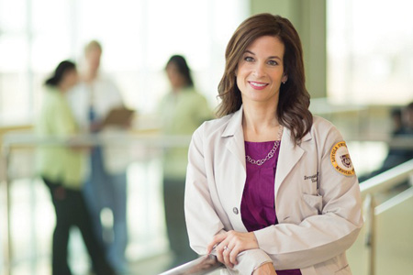

Diversity, Equity and Inclusion: Core Values at Loyola Surgery
Bernadette Aulivola, MD, MS, RVT, RPVI, FACS, DFSVS
Professor and Director, Division of Vascular Surgery and Endovascular Therapy
Vice-Chair for Diversity, Equity and Inclusion, Department of Surgery
Loyola University Medical Center, Stritch School of Medicine

Slide 2
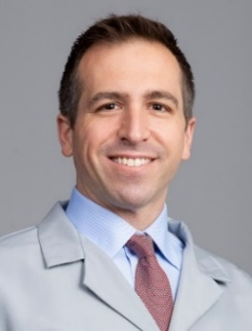
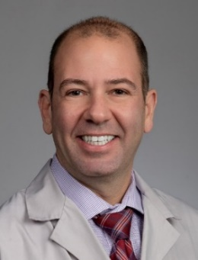
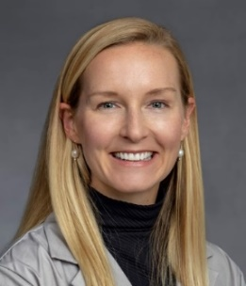
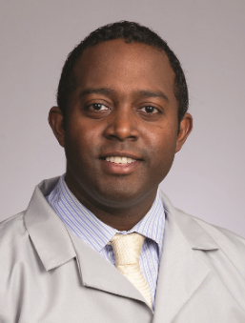
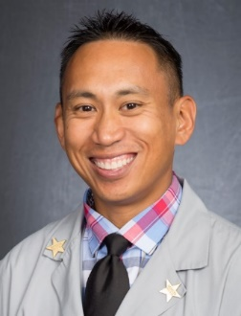
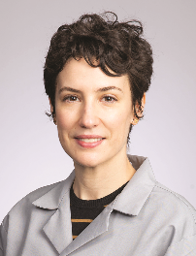
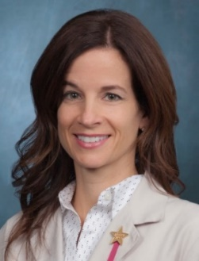
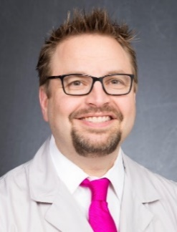
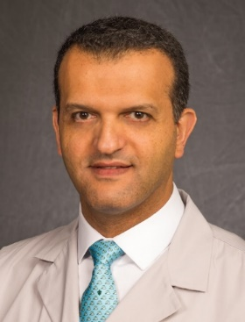
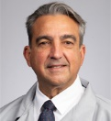
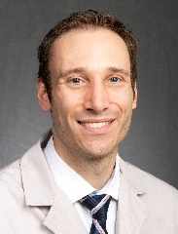
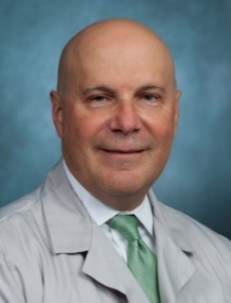
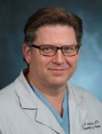
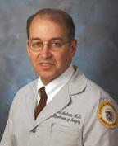
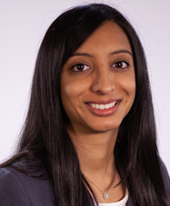
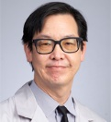
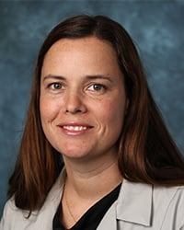
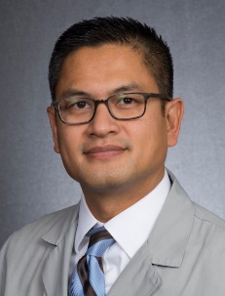
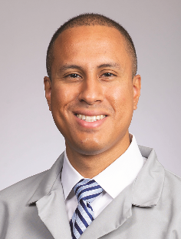
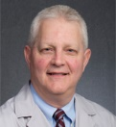
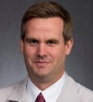
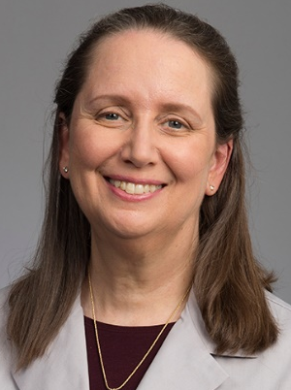
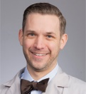
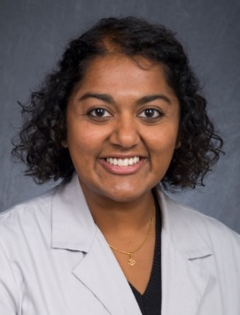
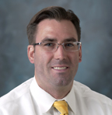
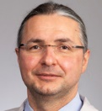
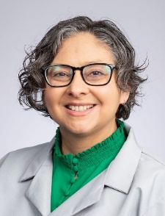
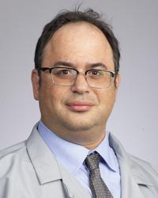
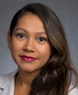
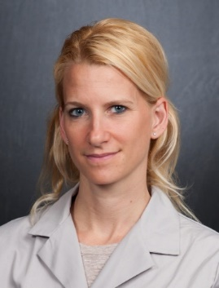
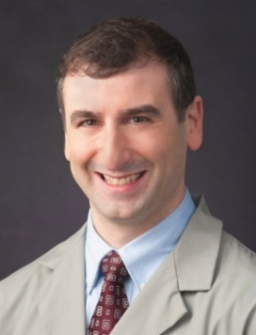
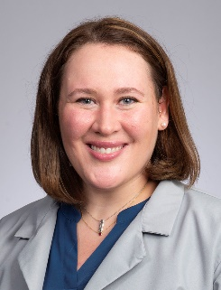
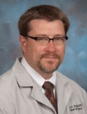
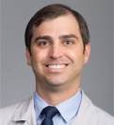
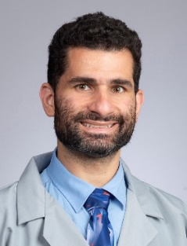
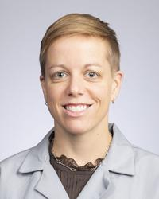
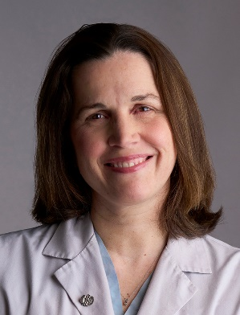
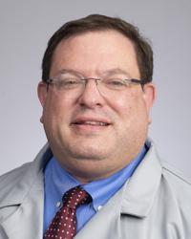
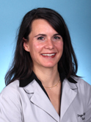
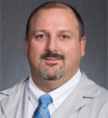
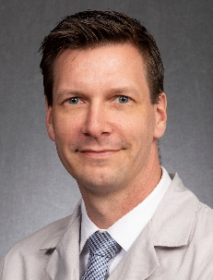
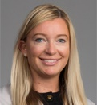
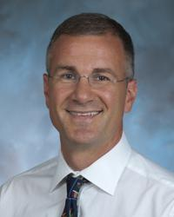
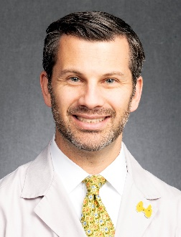

Slide 3
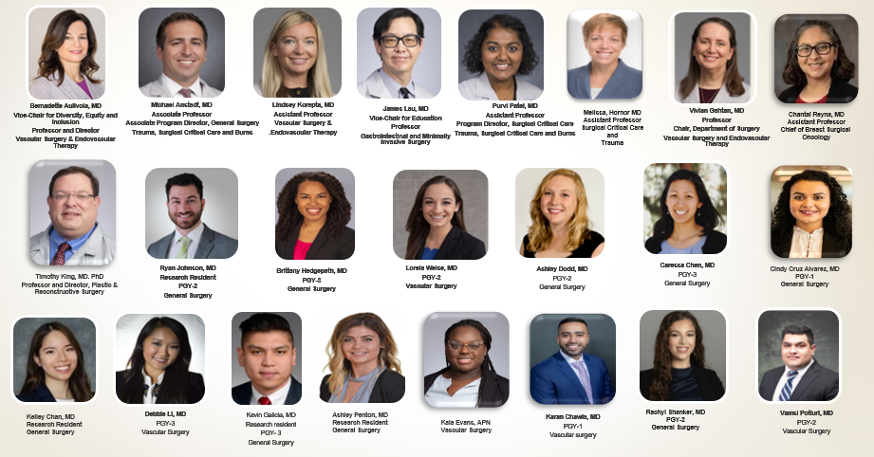
Department of Surgery
Committee on Diversity, Equity and Inclusion
2023-24

Slide 4
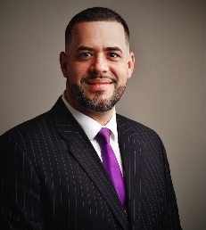
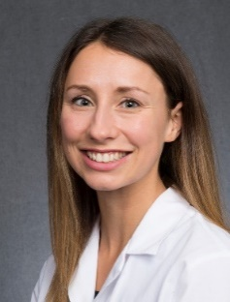
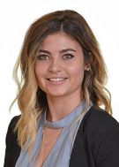
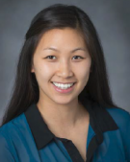



























































Slide 5
Committee on Diversity, Equity and Inclusion
Develop Metrics
Faculty, trainees
Visiting lecturers
Promotion and tenure
Leadership roles
Annual Report
Demographics of faculty and trainees
Inventory of success in recruitment
Evaluation of distribution of leadership roles
Strategic support of promotion

Slide 6
Loyola University Department of Surgery Diversity, Equity and Inclusion

Slide 7
Loyola University Department of Surgery Diversity, Equity and Inclusion

Slide 8


Slide 9





Society Membership Resources
Institutional Memberships
Society of Black Academic Surgeons
Society of Asian Academic Surgeons
Latino Surgical Society
Association of Women Surgeons
Association of Out Surgeons and Allies

Slide 10

Loyola Women in Surgery Group
Established in 2010
Provide a forum for networking opportunities to enhance career satisfaction
Encourage professional development and academic growth
Provide opportunities to mentor and to be mentored by women surgeons
Promote an environment that fosters inclusion, respect and success

Slide 11


Women in Surgery Group Events

Slide 12






Women in Surgery Lectureship

Slide 13





Showcasing our Diversity

Slide 14

GME Events

Slide 15


Education
Implicit bias
Cultural competency
Diversity lectureships

Slide 16

Community Service
Housing Forward
Health Outreach
Street Medicine Program
Health screening events

Slide 17
Investing in our Future
Annual scholarship funding for student, trainee and faculty travel for education and/or professional development focused on healthcare disparities, diversity in surgery, inclusive excellence.

Slide 18

Diversity, Equity and Inclusion: Core Values at Loyola Surgery
Bernadette Aulivola, MD, MS, RVT, RPVI, FACS, DFSVS
Professor and Director, Division of Vascular Surgery and Endovascular Therapy
Vice-Chair for Diversity, Equity and Inclusion, Department of Surgery
Loyola University Medical Center, Stritch School of Medicine
@baulivola
baulivola@lumc.edu

